Slide 1
• Recursion and Applications • Red Black Tree

Slide 2



OUR TEAM
Md Abdullah Al Forhad
Tasneem Jannat Sultan
Md Nadim Hussain
2013-1-60-029
2013-1-60-027
2013-1-60-067
Red Black Tree
Recursion
Introduction

Slide 3
Overview
Introduction
What is recursion?
Applications
How to think recursively?
Some common applications
Red Black Tree
Conclusions

Slide 4
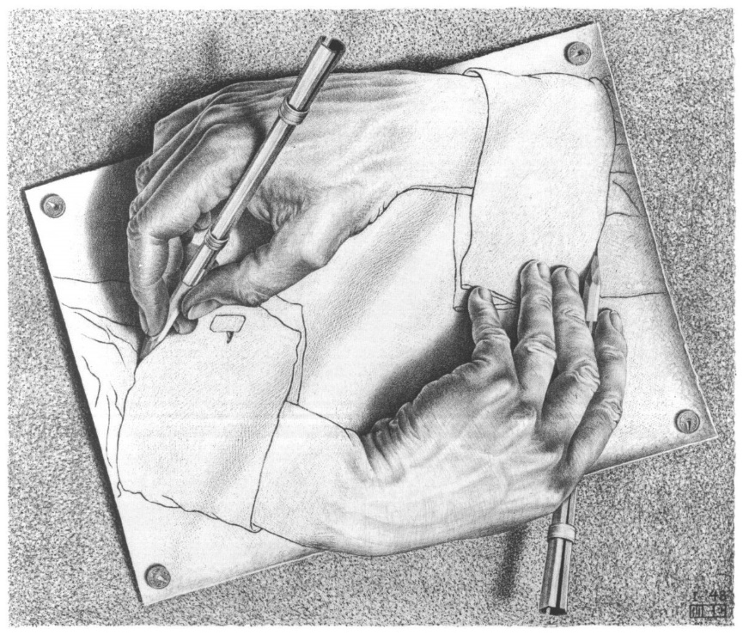
What is Recursion?
Recursion is a principle closely related to mathematical induction.
In a recursive definition, an object is defined in terms of itself.
We can recursively define sequences, functions and sets.
Recursion is an extremely powerful problem-solving technique.
It breaks a problem in smaller identical problems.
It is an alternative to iteration, which involves loops.
A typical example of recursion

Slide 5
How to Think Recursively?
• When coding, do not concern yourself how recursion is unfolding during execution.
• Rather, think of yourself as a boss, and treat each recursive call as an order to one of your trusted subordinates to do something.
• As a boss, you need not worry how the subordinate does their work. Instead, take the outcome of their work.
• Finally, take the outcome of the subordinate’s work, and use it to compute by yourself the final result.

Slide 6
Some common applications
Some common recurrence relations are:
Golden Ratio :
Factorial :
Fibonacci Numbers :
Catalan Numbers :
Red Black Tree
,

Slide 7
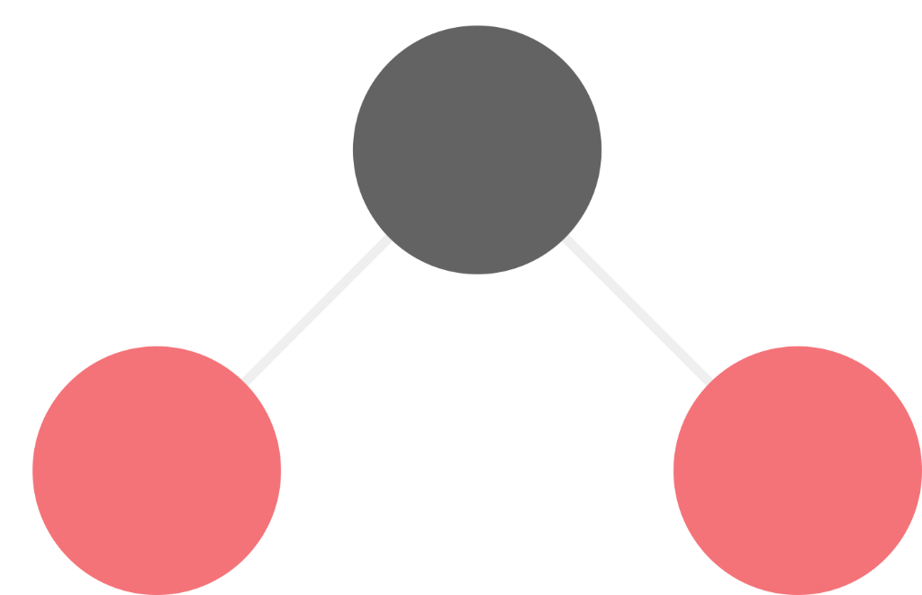
RED BLACK TREE

Slide 8
What is Red Black Tree?
Red Black Tree is a type of self balancing binary search tree. Its design ensured five specific properties are preserved.
Every node is either red or black
The root is black.
Every leaf (NULL pointer) is black
If a node is red, both children are black
,
Every path from root to descendent leaf contains the same number of black nodes

Slide 9
Insertion into a Red-Black Tree
Algorithm for insertion: Color changing
Case 0: The color of a new leaf is always red. If parent of new leaf is black, then done.
Case 1: We just change colors.
2
2
2
7
7
1
7
1
1
5
5
5
If sibling of parent also red, change color of parent and its sibling to black, and change color of the grandparent.
2. Ensure color of the root is black.

Slide 10
Insertion into a Red-Black Tree
Tree rotation
What if parent does not have a red sibling?
Case 2: One rotation suffices
2
2
5
5
5
2
7
7
7
Change the color of the parent to black, change the color of the grandparent to red.
2. Rotate to restore the 4th invariant.

Slide 11
Insertion into a Red-Black Tree
Double Rotation
One rotation works for right-right or left-left tree.
Case 3: Tree is right-left (or left-right), then we need double rotation
2
2
2
5
5
5
2
7
7
5
7
7
1. Rotate right-left tree to right-right tree.
2. Change color of parent and grandparent.
3. Rotate to restore the 4th invariant.

Slide 12
Pseudo Code of insertion
bool insert ( Tree &root, Item_Type item )
if(root == NULL)
root = new black node;
return true;
else if(item == root->data)
return false;
else if (item < root->data)
if(left == NULL)
left = new red node;
return true;
else if((left == red) && (right == red))
change left and right to black
and color the local root red;
if(insert(left,item))
if(left grandchild == red)
change left to black
and color the local root red;
rotate the local root right;
else if(right grandchild == red)
rotate the left child left;
change left to black
and color the local root to red;
rotate the local root right;
else // item > root->data: exercise
if(local root is root of the tree)
color the root black.

Slide 13
Deletion in Red Black Tree
Case A: Delete red node
N
N
,

Slide 14
Deletion in Red Black Tree
Case B: Delete black node
N
N
N
N
,

Slide 15
Deletion in Red Black Tree
Case C: Delete black node with black child
N
N
But It creates problem with red black tree property no 5
5. Every path from root to descendent leaf contains the same number of black nodes
,

Slide 16
Deletion in Red Black Tree
Case 1: If siblings of current node is red
S
P
S
N
P
R
S
P
L
R
N
L
1. First rotate the parent so that current nodes parent is not changed
2. Recolor the parent red and former sibling black
,

Slide 17
Deletion in Red Black Tree
Case 2: If siblings of current node is black
P
P
N
S
N
S
L
R
L
R
1. Change the color of sibling
,

Slide 18
Deletion in Red Black Tree
Case 3: Parent of current node red
P
P
N
S
N
S
L
R
L
R
1. Change the color of parent and sibling
,

Slide 19
Deletion in Red Black Tree
Case 4: Siblings left child red and right child black
L
L
S
S
S
L
R
R
1. Rotate it
2. Recolor it
,

Slide 20
Conclusion
Red–black trees offer worst-case guarantees for insertion time, deletion time, and search time.
The AVL tree is another structure supporting O(log n) search, insertion, and removal. It is more rigidly balanced than red–black trees, leading to slower insertion and removal but faster retrieval.
,

Slide 21
Any Questions?
,

Slide 22
Thank You!
,

